Slide 1
MILLENNIUM PROMISE-KENYA
Supported by Goj.

Slide 2
PRESENTERS:
Jessica Masira-Team Leader/Cluster Manager
Dr. Donald Apat.- Health Coordinator

Slide 3
The Millennium Villages Project: 2005-2015
Launched in 2005-2006, the Millennium Villages Project (MVP) is an integrated rural development program that addresses the root causes of extreme poverty through a holistic, community-led approach to sustainable development. Its aim is to build systems to deliver critical, basic services for agriculture, health, education, and water and sanitation and thereby contribute towards the achievement of the Millennium Development Goals (MDGs) in low-income rural sub-Saharan African (SSA) villages,

Slide 4
. Over the past decade, the MVP has been promoting a comprehensive package of low-cost, science-based interventions and practices within the budget structure recommended by the United Nations Millennium Project. The original MVP serves a population of half a million people in 10 countries across SSA, with scale-up initiatives launching throughout the region.

Slide 5
Mission Statement
The mission of Millennium Promise is to advance sustainable development in communities across rural Africa using innovative solutions and scalable systems aimed at achieving the Sustainable Development Goals including the end of extreme poverty.

Slide 6
About us.
At Millennium Promise, we believe that the Sustainable Development Goals (SDGs), including the end of poverty, can be achieved by 2030, even in the most challenging and remote parts of the world.
By mobilizing cutting-edge science and technology for effective local development, Millennium Promise seeks to accelerate sustainable development across rural sub-Saharan Africa and beyond.
From 2005-15, Millennium Promise provided the operational platform and resource mobilization for the Millennium Villages Project which deployed a holistic, science-based approach to accelerate progress on the Millennium Development Goals for more than 500,000 people across sub-Saharan Africa.
Today we build on this work to implement the SDGs at the sub-national level through several initiatives, including the Sustainable Districts Program, Connect To Learn, and the One Million Community Health Workers Campaign

Slide 7
Defining Elements of the MV Approach .
Integrated multi-sectoral approach
Best science, knowledge and experience
Community participation, ownership and leadership
Partnerships of communities, Government, UN, and other development partners
Driven by a rural economic transformation, backed by capacity building

Slide 8
Phases1&2.
The first phase of the MVP covered the period from 2005-2006 to 2010-2011. The second phase covers the period from 2010-2011 to mid-2016. During the first phase of the Project, the MVP focused on addressing challenges of availability of and access to basic services, while the emphasis during the second phase was on demand, continuity, and quality of these services

Slide 9
Interventions:
Agriculture and Business Development:
Green house farming .
Transforming sub-subsistence farmers to small entrepreneurs
Fertilizers (subsidized), improved seeds;
Market service center Established
Links with MFIs, agro-input dealers &markets.
High value and nutritious crops – g/nuts, TC bananas, onions, kales, tomatoes etc.;
School meals with locally produced foods.

Slide 10
Supplementing SMP

Slide 11
Education: Emphasis on girl child
interventions
Girls benefiting from the award.
Sanitation - Latrines
Bursaries for bright pupils
Mentoring
Sanitary Pads for girls (2,300 in Sauri)

Slide 12
Health
MVP has been establishing and training a cadre of CHWs to significantly reduce child and maternal mortality by creating a continuum of care from household to clinic and referral hospital. Experience gained in MVP sites demonstrates that the CHW program is critically important for the achievement of health-related development goals and an essential component of a successful community level health care delivery system.

Slide 13
Community Health Worker Program Principles.
Function | Principle
Professionalization and Organizational Management | CHWs are a professional cadre of health workers provided remuneration, training, and supportive supervision, and held accountable through robust management systems.
Innovation and Technology | The CHW program is supported by global innovations such as mobile health technology for effective and efficient screening, treatment, and prevention of disease.
Health System Integration | The primary care system is embedded within a robust public health system, where CHWs serve as a critical link between households and primary clinics
Quality Assurance | Through the use of real-time data and locally based managers, the quality of the program and services delivered are constantly assessed and improved to ensure a continued ability to meet local needs and satisfaction.

Slide 14
One of Our significant intervention in health.
Coming of Age: HIV Exposed Infants (HEI)Graduation Ceremonies at 18 months.

Slide 16
Introduction.
E-MTCT is based on closed follow-up HIV exposed infants and mother infant pairs through the various stages of the PMTCT cascade:
Attend institutional ANC (early)
Offer & Accept HIV test
HIV testing & Dissemination of results
ART prophylaxis & nutritional counseling
( infant)
ART prophylaxis ( mother)

Slide 17
Model Mother
BENEFITS
High level of attrition at each step of the cascade is a threat to achieving the desired outcomes:
HIV free survival and decreased morbidity & mortality in HIV exposed infants
Decreased morbidity & mortality in infected women

Slide 18
objective
The MVP HEI graduation program seeks to enhance follow-up of HIV exposed mother – infant pairs from the first ante-natal visit to 18 months after delivery

Slide 19
Methodology step 1
Pregnant mothers who turn positive are registered and attached to model mothers who offer psychological support and encourage them to attend ANC visit

Slide 20
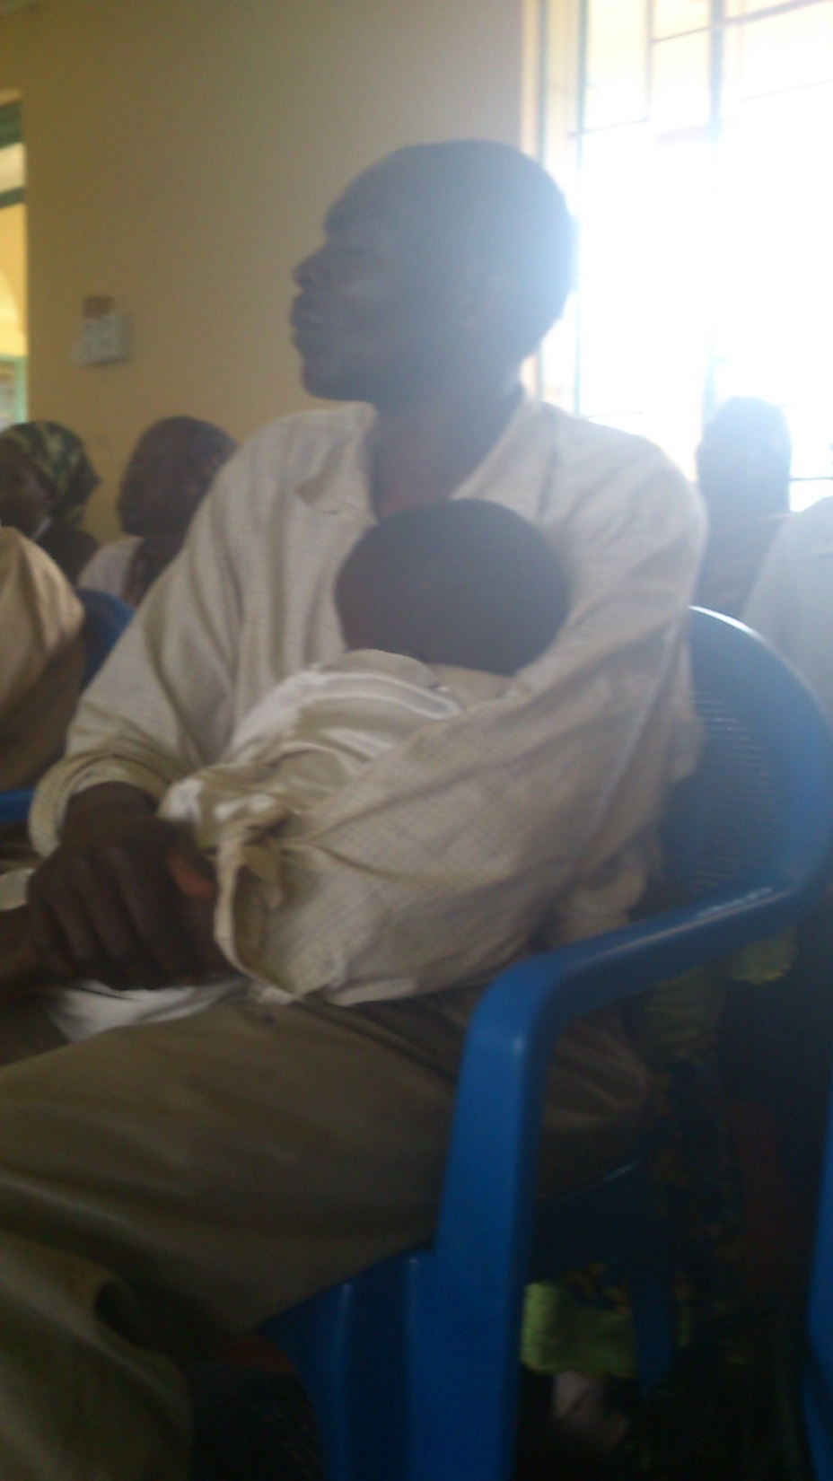
Step 2
Post-delivery, the model mothers/PMTCT youth support groups and CHWs support close follow-up of HIV exposed mother-infant pairs. This achieved through:
Table banking meetings
Siri ya jikoni (kitchen shopping for PMTCT mothers)
Kitchen gardens support

Slide 21
Step 3
The post-delivery follow-up culminates in the HIV-exposed infant (HEI) graduation ceremony at 18 months, which heralds a turning point in the continuum of care for HEIs and their mothers
Conducted quarterly

Slide 22
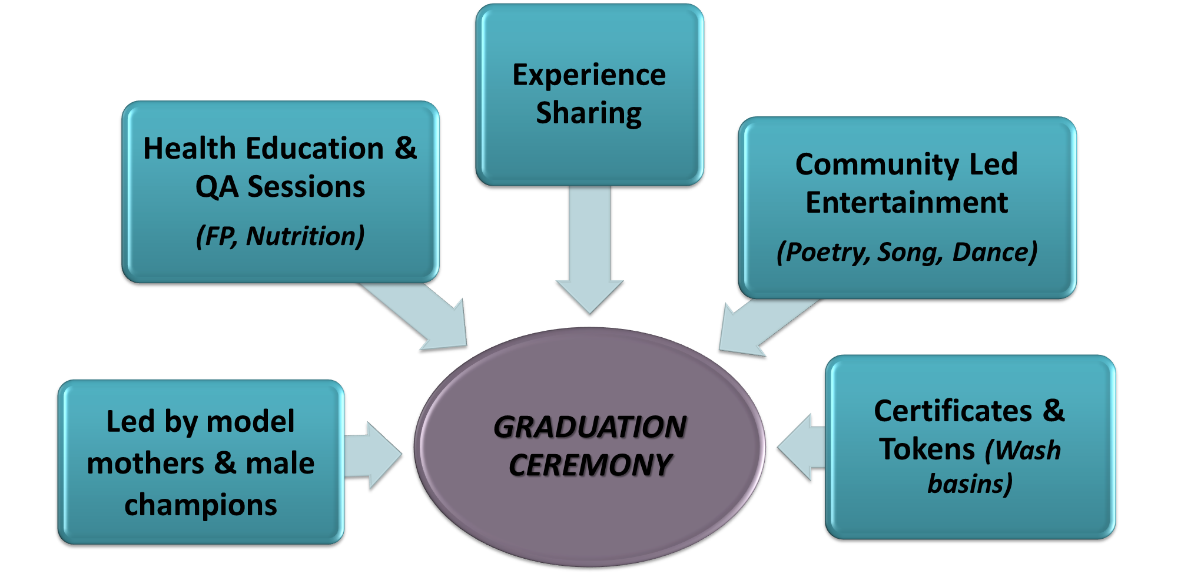
STRUCTURE OF THE GRADUATION CEREMONY:

Slide 23
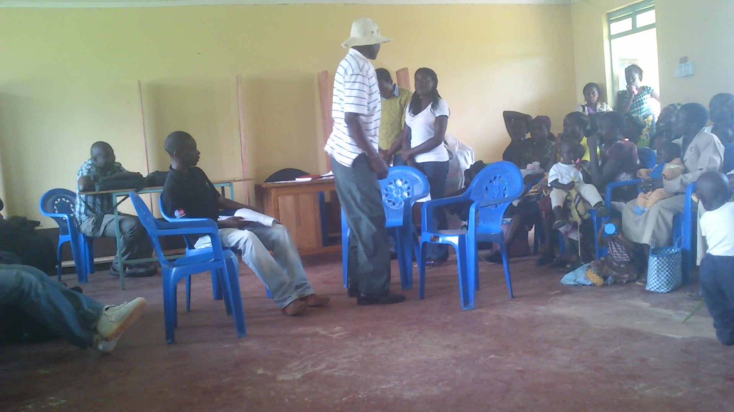
Role play by Youth group

Slide 24
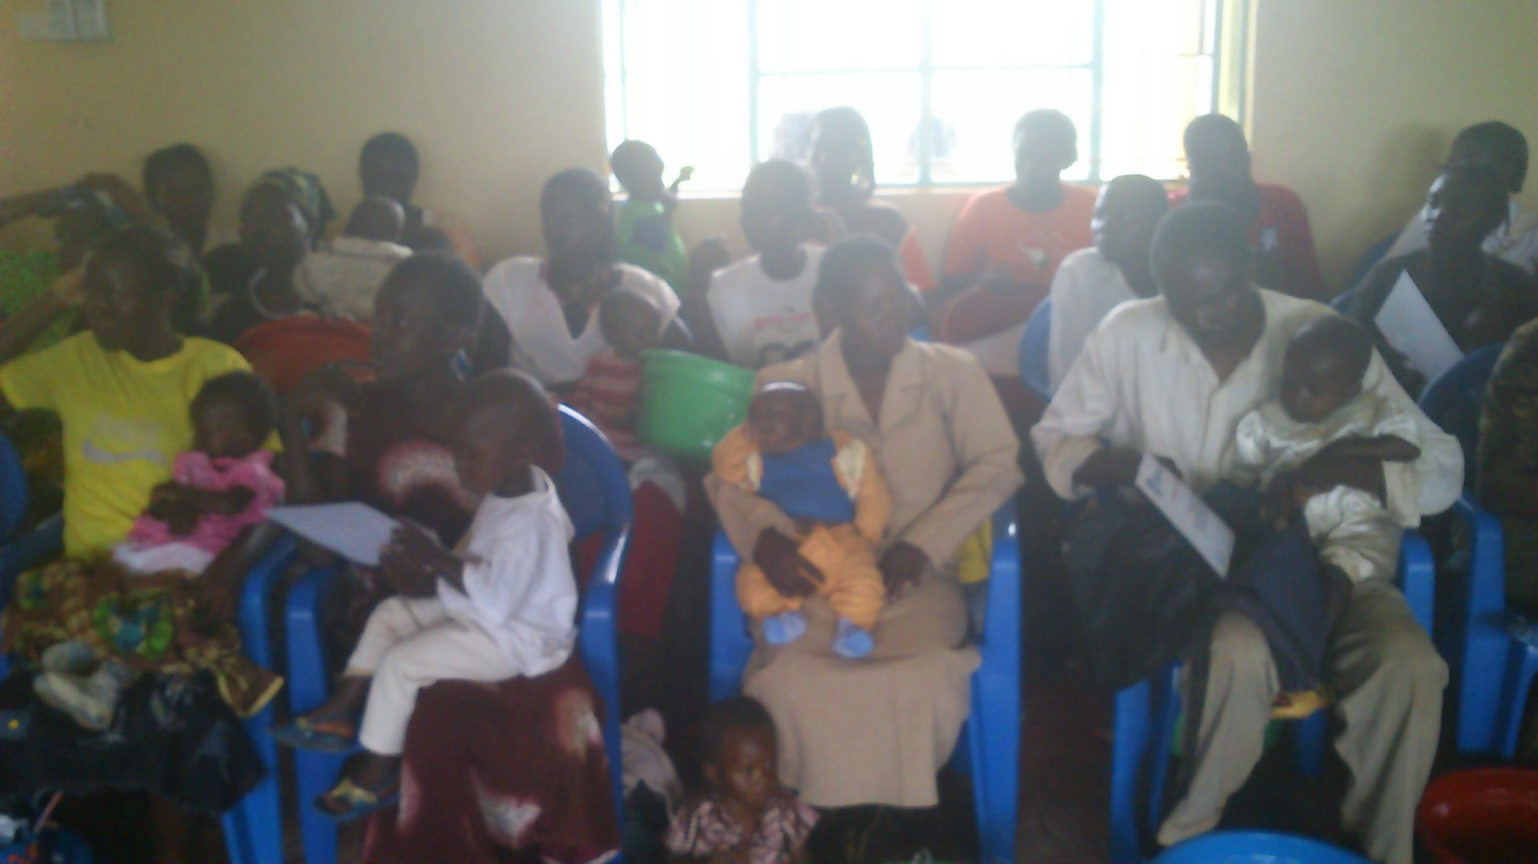
Mothers & children assembled at the graduation ceremony

Slide 25
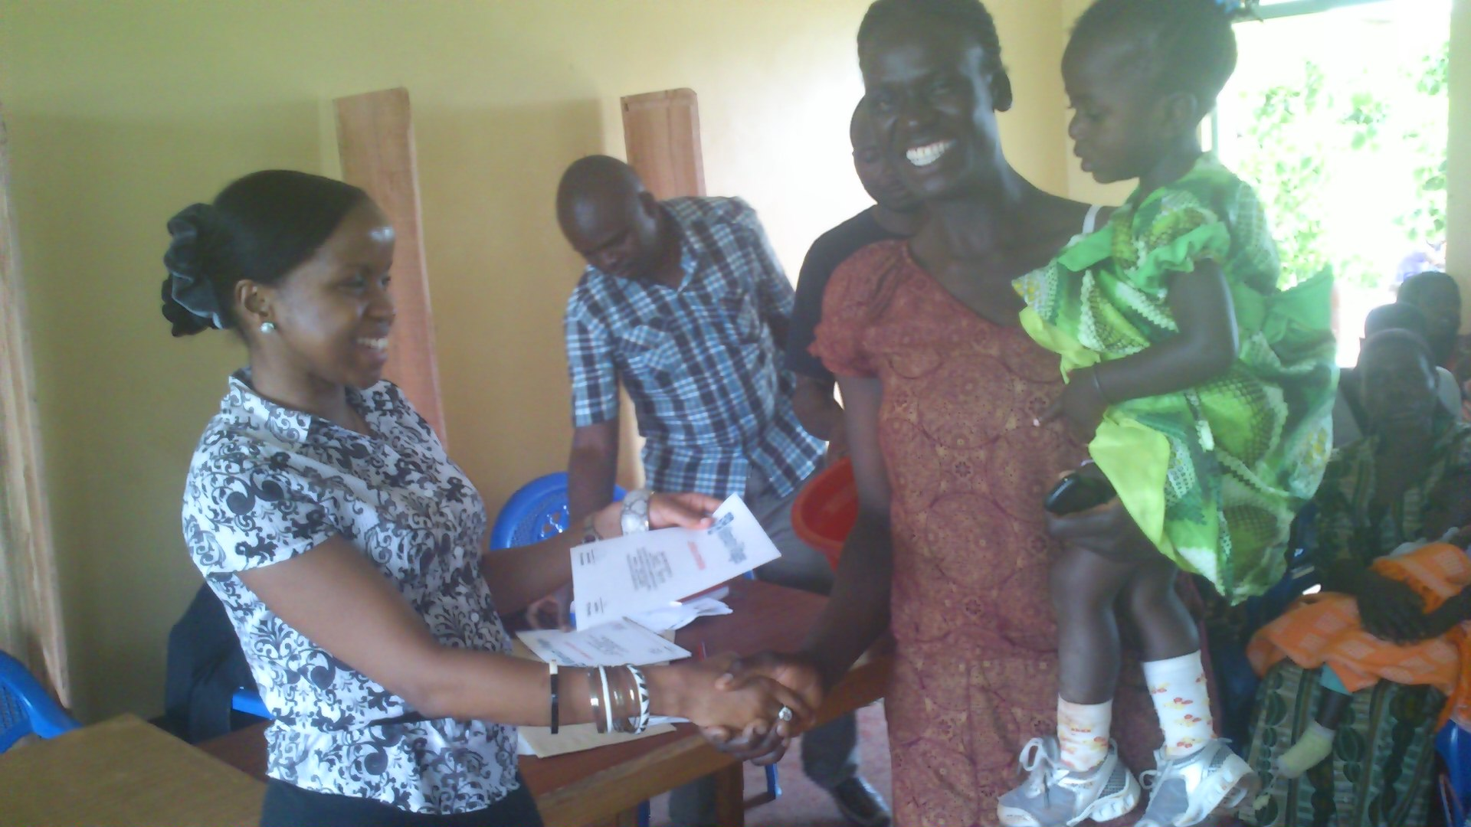
Mothers & children receiving certificates & tokens during ceremony

Slide 26
Lessons learnt
Graduation ceremony serves as an incentive for mothers to attend post-delivery visits up to 18 months
The steps leading up to the ceremony strengthen the links in the PMTCT cascade hence reducing attrition
The event serves as a platform for HIV infected mothers to self-disclose their HIV status and to receive community support
It is an opportunity for the graduating mothers to enroll as model mothers

Slide 27
HEI GRADUANT (2014)
Briggs Faith Marenya
TODAY AUGUST 2016

Slide 29
The graduation ceremonies are well attended and contribute to the retention of HIV exposed mother-infant pairs along the PMTCT cascade.

Slide 30
Transition to SDGs.
UNFINISHED BUSINESS?
YES!

Slide 31
SDGS.
In 2016, Millennium Promise (MP) launched the Sustainable Districts Program (SDP), which builds on the innovations and systems developed by the Millennium Village Project (MVP), as well as its lessons and challenges

Slide 32
MP MANDATE.
MP will promote the operationalization of the SDGs at the district level through the delivery of five main components:
Policy Advising: informing national rural development policy based on the SDGs and MVP
Capacity Building: strengthening managerial and technical capacities of local governments and community-based organizations
Investment Promotion: developing the district into an investment-friendly area by promoting infrastructure development, community-based service delivery, and income generating activities
Local Leadership: fostering and strengthening capacities of village-level leadership
M&E: developing a performance-based Monitoring and Evaluation system

Slide 33
Sectoral Programs
7 sectoral programs built from SDGs and based on MDG Centers expertise
Sustainable agriculture and economic development
Health systems
Education systems
Infrastructures (Energy , water , ICT )
Gender and Governance
Ecosystems and Climate( What about Rural settlements)
Information systems including M&E

Slide 34
Operationalization process
Planning
Implementation
M&E
Planning
Identification of SDGs , targets and indications relevant at subnational level
Baseline
Need assessment
Costing
Integration into the local planning

Slide 35
SDP/County.
Ministerial Department :Local Government , decentralization , planning
Planning entities /National steering committee
Interaction of elective axis and the administrative( nominative) axis from village to district /county level
Planning system and cycle to be used taking into consideration units and subunits ( village to county ) /in relation to national planning systems ( start and end)
Articulation with short term , medium and long term plans , strategies and programs
What expertise is available at district level in quality and quantity compared to MP expertise ?
Budget cycle( start and end ) and amount
Harmonizing MP budget cycle with Government budget cycle
Entry point at County : Planning unit ? Supporting planning , helping targeting budget allocation , support the monitoring of the budget implementation based on a performance based M&E system

Slide 36
SDPS.
As we transition to the next development agenda (SDGs), there is convergence in understanding that the degree of ownership of the proposed Sustainable Development goals (SDGs) is higher than for the MDG agenda, offering a ray of hope that the Post 2015 era could usher in an era for renewed optimism about where Siaya county and the rest of the country is heading.
The purpose of localizing the SDGs in Siaya County will be to promote innovations such as local financing solutions and also to ensure that the people of Siaya County understand the SDGs and know their responsibilities towards attaining them.

Slide 37
Current Status of Localization of SDGs in Siaya County. AGRICULTURE
• As much as the county staff may not fully articulate the SDGs and how they are integrated in the county annual budget (2015/2016), a study of the Siaya county budget reveals that the county is implementing the SDGs in their integrated program based budget.
In the 2015/2016 FY,Agriculture department aims at increasing adoption of irrigation, linking farmer’s to providers of affordable credit facilities, providing post harvest produce handling facilities, spray crushes and acaricides as well as productive livestock breeds and associated services.
The department further aims at providing suitable conditions and recruit and recovery of fish stocks, modern marketing infrastructure, good quality and quantity of farm inputs, timely extension services as well as provision of livestock vaccination, diagnostic and treatment services

Slide 38
WATER
In view of SDG goal 6; the department of water, environment and natural resources envisions to provide sustainable access to adequate safe water and sanitation in a clean and secure environment.
In the 2015/2016 FY, the sector envisages to undertake rehabilitation/ augmentation, operations and maintenance of existing water facilities, construction of new water supplies and increasing the forest cover.

Slide 39
HEALTH &EDUCATION.
The department of health services intends to build progressive, responsive and sustainable technologically-driven, evidence-based and client-centered health system for accelerated attainment of highest standard of health to all people of Siaya County.
The department of education, youth affairs, gender and social services intends to provide, promote, monitor and evaluate the provision of quality education, gender equity, care and protection of children and other vulnerable group in social development as integral part of Siaya County development.

Slide 40
WHAT NEEDS TO BE DONE.!
The county government has not fully internalized the SDGs despite the fact that in the county integrated budget plan it is evident that some of the goals are entrenched. It is therefore prudent to engage with the county government, civil society and NGOs into concrete discussions on the means of implementation.
Inclusive and participatory dialogue can help to transform challenges with the implementation of the agenda by generating a greater diversity of ideas and potential solutions and by channeling expectations of stakeholders into dynamic and constructive pathways (and possible partnerships) through;

Slide 41
Cont:
Advocacy: To ensure that people in Siaya are aware about the SDGs and have the capacity to engage actively.
Ownership: To enhance commitment of the county government and NGOs to engage in the Post 2015 process and to further the implementation of the SDGs by engendering higher levels of buy-in.
Policy Integration: To facilitate and stimulate the discussion with stakeholders on the alignment and integration of the Post 2015 development agenda and the SDGs within National (vision 2030) and county development plans and their implementation on the local level.
Financing: To discuss with local leaders ways of mainstreaming the SDGs into their budgets and plans at their respective levels and to discuss innovative solutions for financing the Post 2015 agenda.

Slide 42
Conclusion.
Through the lessons learnt while implementing the MDGs in one of the sub-counties, it is envisaged that development practitioners with the support of donor communities can build on these works to successfully implement the SDGS.

Slide 43
THANKS.

